Slide 1
Road Accident Data 2020 India - In-depth Analysis
Comprehensive Insights into Accident Causes, Outcomes & Trends in Indian Cities
Presented by Aashirwad Mehare

Slide 2
Project Overview
Objective:
To analyze road accident data from 50 major cities in India for the year 2020.Focus on identifying patterns, key causes of accidents, outcomes, and high-risk cities.Utilize data to make policy recommendations for improving road safety.

Slide 3
Project Overview
Dataset Details:
Sourced from the Government of India.9550 records covering cities, cause categories, accident subcategories, outcomes, and count of incidents.
Technologies & Tools:
Python: For data cleaning, analysis, and visualization.
SQLite3: Database used for structured storage and querying.
Power BI: Dashboard creation for interactive, visual data representation.

Slide 4
Dataset Features
Million Plus Cities: Cities with populations over 1 million, including Delhi, Mumbai, Kolkata, etc.
Cause Categories:
Traffic Control (e.g., traffic signals, police control),
Junction (e.g., roundabouts, intersections),
Road Features (e.g., road curvature, ongoing construction),
Impacting Vehicle/Object (e.g., collisions with other vehicles or objects),
Weather Conditions (e.g., fog, rain).

Slide 5
Dataset Features
Outcomes of Accidents:
Fatalities (number of people killed),
Grievous Injuries,
Minor Injuries,
Total Injuries.

Slide 6
Data Processing Pipeline
Data Loading:
Loaded raw accident data into Pandas for initial inspection.
Dataset included city names, causes of accidents, and outcomes.
2. Data Cleaning:
Handled Missing Values: Filled missing data where possible, or dropped rows/columns with insignificant missing values.
Data Type Consistency: Ensured all columns (e.g., Count, Cities, Cause Categories) had the correct data types.

Slide 7
Data Processing Pipeline
3. SQLite Database:
Created an SQLite database to store and query accident data.
Efficient querying enabled complex aggregations like accidents by city or cause category.

Slide 8
Exploratory Data Analysis (EDA) Process
Purpose of EDA: To explore the dataset and uncover meaningful patterns in the accidents data.
EDA Steps:
Distribution of Accidents Across Cities: Querying accident counts by city to identify which cities had the highest or lowest accident rates.
Visualization: Bar charts representing city-wise accident distribution.

Slide 9
Exploratory Data Analysis (EDA) Process
Analysis by Cause Categories:
Breakdown of accidents based on cause categories such as Traffic Control, Road Features, and Weather Conditions.
Visualization: Countplots showing the frequency of each cause.
Outcomes of Accidents:
Identified how many accidents resulted in fatalities, grievous injuries, or minor injuries.
Visualization: Bar charts of outcomes based on the severity of incidents.

Slide 10
Visualizations Using Python
1. Accident Distribution by City:
Created visualizations using Matplotlib and Seaborn.
Highlighted cities with the highest accident rates (e.g., Delhi, Mumbai, Bengaluru).
Key Findings: Some cities, especially Delhi, Mumbai, and Chennai, reported a high number of road accidents, with notable peaks during adverse weather conditions.

Slide 11
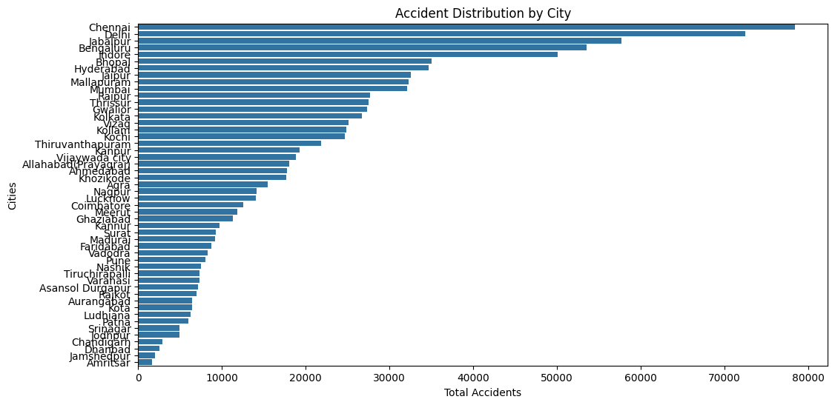
Visualizations Using Python

Slide 12
Visualizations Using Python
2. Accident Causes Analysis:Used stacked bar charts to represent accident causes and their correlation to different outcomes like deaths or injuries.
Key Insight: Traffic Control failures and Junctions were primary contributors to severe accidents.

Slide 13
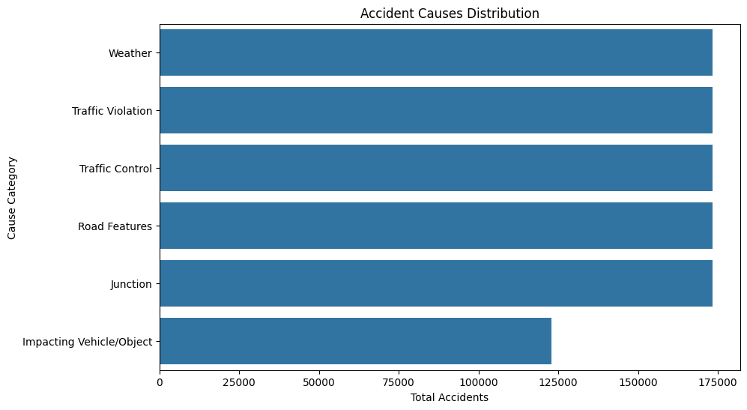
Visualizations Using Python

Slide 14
Visualizations Using Python
3. Weather Impact on Accidents:Analyzed how weather conditions such as fog, rain, and clear skies impacted accident rates.
Key Findings: Accidents increased during rainy and foggy conditions, while clear weather still saw a significant number of incidents.

Slide 15
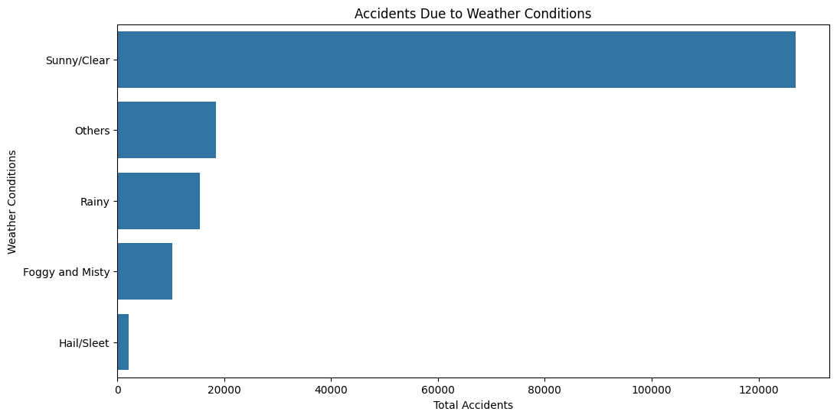
Visualizations Using Python

Slide 16
Power BI Dashboard Development
Dashboard Overview:Built an interactive Power BI dashboard to enable decision-makers to easily explore data.
Visualized key metrics such as:
Accidents by City: Bar chart showing accident count for each city.
Accidents by Cause Category: Filterable view of accidents based on road features, vehicle types, and more.
Injury & Fatality Analysis: Focused on understanding which causes led to the most severe outcomes.

Slide 17
Power BI Dashboard Development
Dashboard Interactivity:
Slicers & Filters: Enabled users to drill down by cause subcategories, outcome types, and cities.
Mapping Feature: Displayed geographic accident data for better location-based analysis.

Slide 18
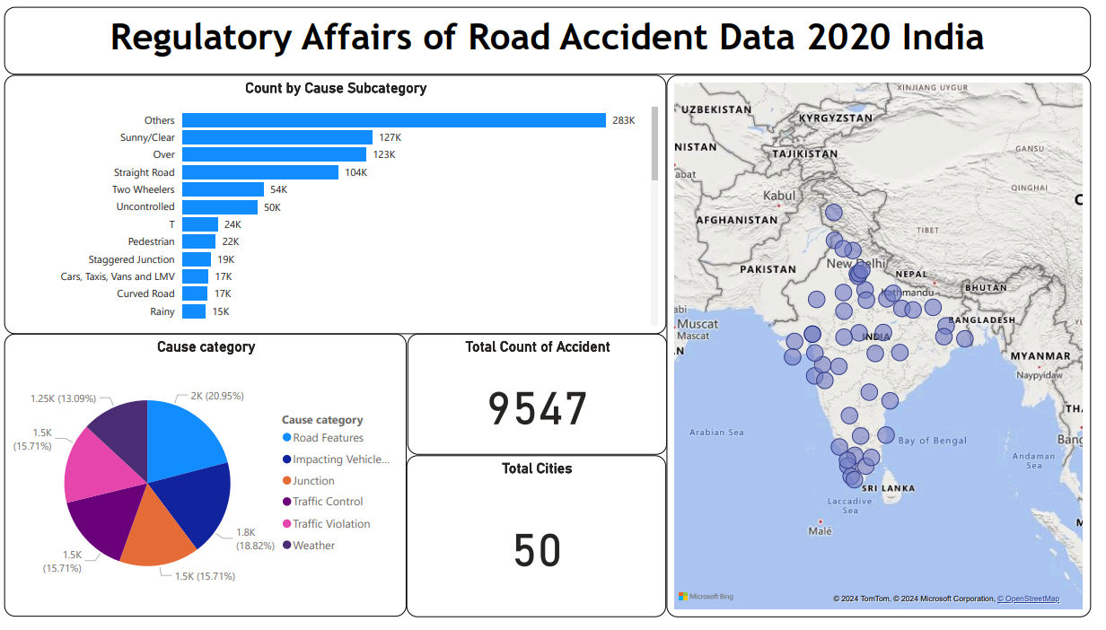
Power BI Dashboard Development

Slide 19
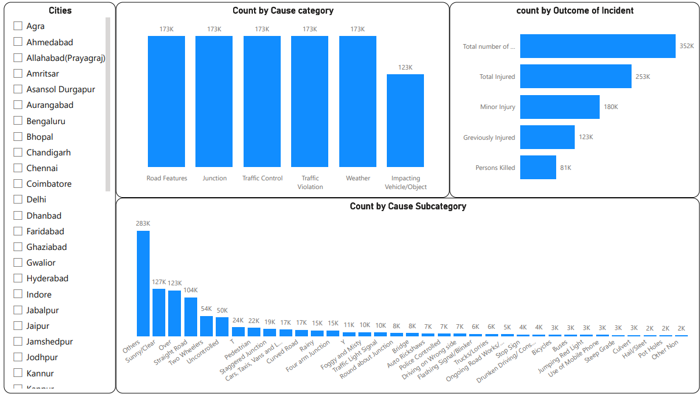
Power BI Dashboard Development

Slide 20
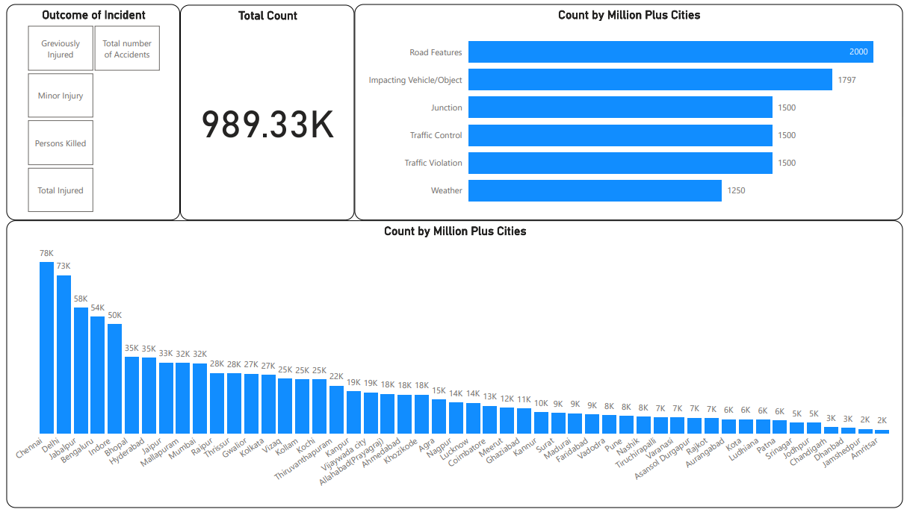
Power BI Dashboard Development

Slide 21
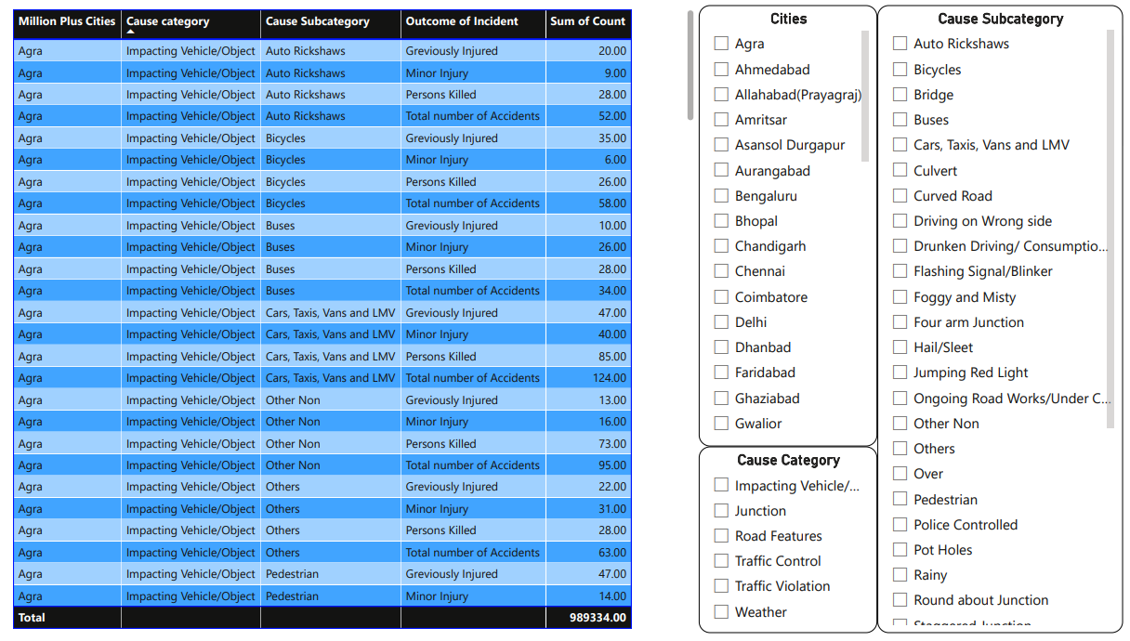
Power BI Dashboard Development

Slide 22
Key Insights from the Analysis
Cities with Highest Accidents:
Delhi, Mumbai, Chennai had the highest accident rates.
Focus on improving traffic regulations and infrastructure in these regions.
Major Accident Causes:
Traffic Violations (e.g., jumping red lights, driving on the wrong side) and road conditions (e.g., ongoing roadwork, pot-holes) were significant contributors.

Slide 23
Key Insights from the Analysis
3. Weather Impact:
Severe weather conditions like fog and rain significantly increased accident rates, suggesting a need for better visibility measures and road safety protocols.
4. Outcome Analysis:
A higher percentage of accidents led to minor injuries; however, a substantial number still resulted in fatalities, particularly in traffic violation cases.

Slide 24
Recommendations for Road Safety
Focused Intervention in High-Risk Cities:
Prioritize improving infrastructure and enforcement in cities like Delhi, Mumbai, and Chennai.
Traffic Control Measures:
Implement stricter regulations at high-risk junctions and enforce compliance with traffic signals.

Slide 25
Recommendations for Road Safety
Weather-Based Safety Protocols:
Introduce road safety measures for foggy and rainy conditions, such as improved street lighting, visibility markers, and weather-alert systems.
Educational Campaigns:
Increase public awareness regarding safe driving practices, particularly in high-risk weather conditions and junctions.

Slide 26
Conclusion & Future Work
Conclusion:The analysis provided valuable insights into road accidents across Indian cities, highlighting the need for enhanced traffic management, road infrastructure, and safety protocols.
The interactive Power BI dashboard serves as a powerful tool for policymakers to identify accident-prone areas and causes.

Slide 27
Conclusion & Future Work
Future Work:
Extend the dataset to analyze trends over multiple years.
Develop predictive models to anticipate accident hotspots based on traffic, weather, and road conditions.

Slide 28
Thank You!
LinkedIn :- linkedin/aashirwad-mehare
GitHub :- github/Aashirwad0123
Presented by Aashirwad Mehare

